Slide 1
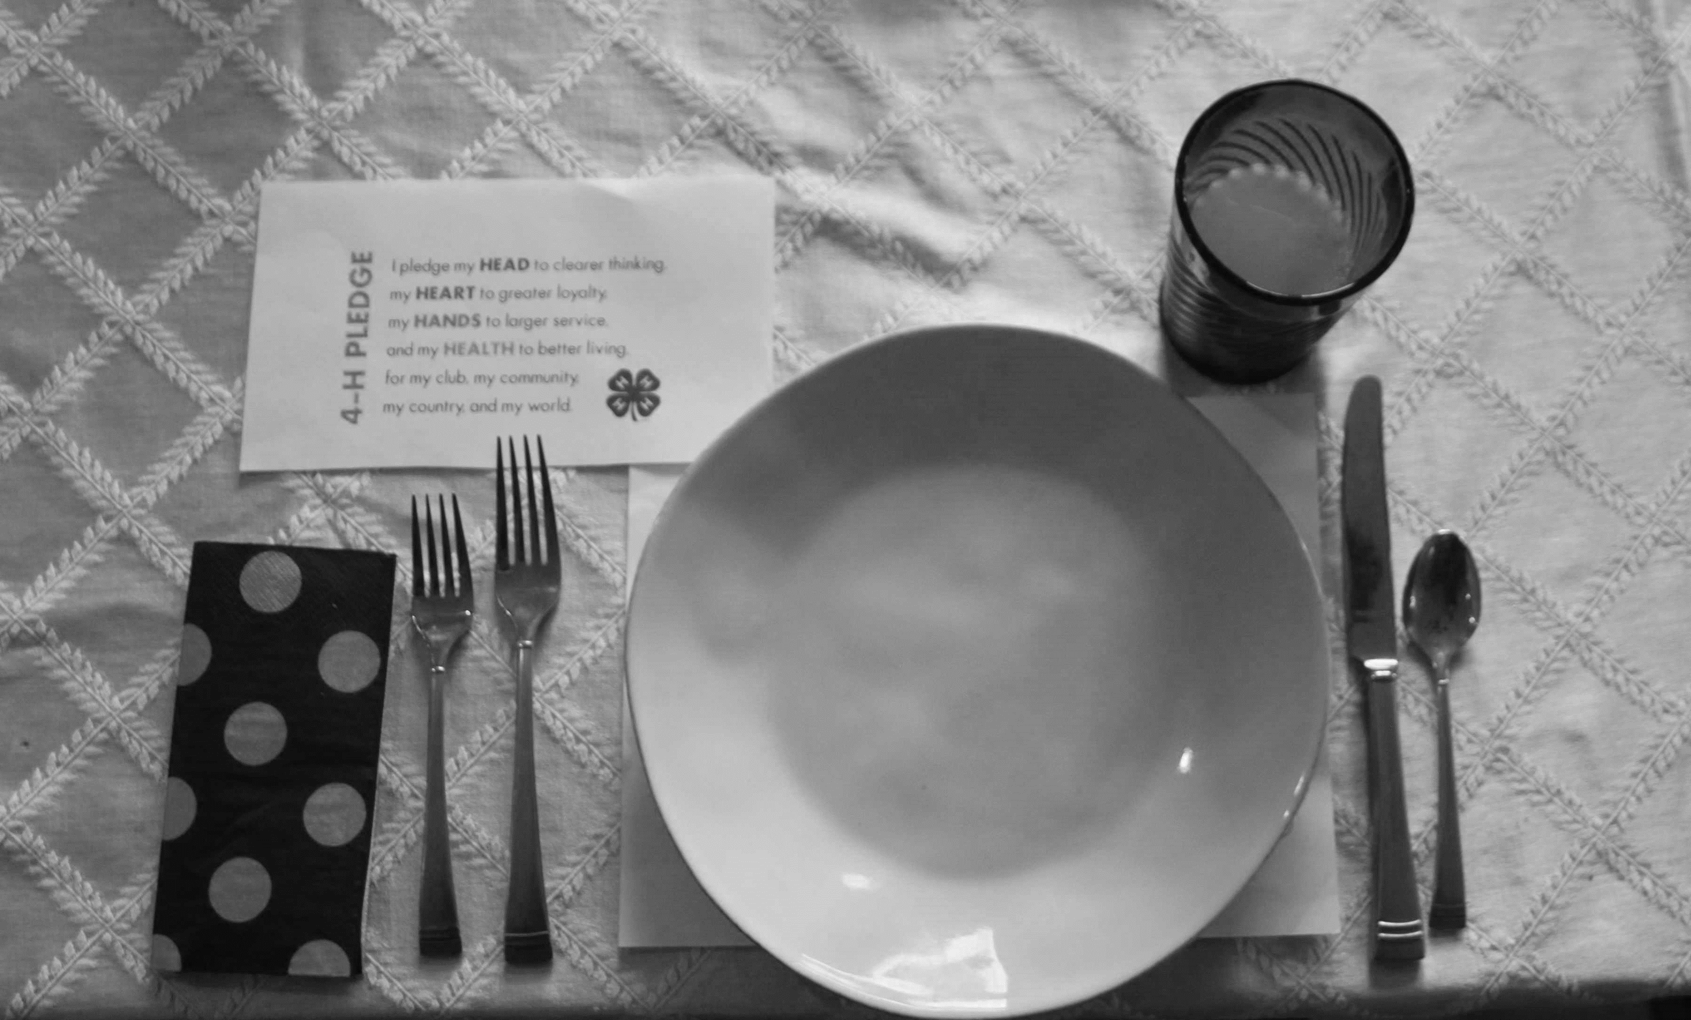
Food Show Table

Slide 2
AGE DIVISIONS
JR – Ages: 7-9
Intermediate – 10-13
SR – 14 & Older

Slide 3
On the day of the show, only one food item should be prepared and exhibited along with a copy of the recipe on an 8" x 11" card, plus the menu for the meal/snack on an 8" x 11" card - place in a self-supporting stand(s) furnished by the participants.
Bring a card table to show your display, correct table setting, and centerpiece.
Centerpieces may be original designs or purchased, for example, fresh flowers or artificial. Use whatever theme you like--no restrictions as long as it’s appropriate.
Dress should be appropriate for the menu and table setting used.
Hot foods should be kept hot and cold foods cold. Only bring enough food for your display and a sample for the judge. Please do not bring extra food to share with the public or other 4-H members for food safety reasons.
If you plan to use your table for a Project/Demonstration Talk, the Creative Table Judge will wait for your availability. Check with your local office for the time & date.
What you should know to tell the judge: How to prepare and serve the food. Tell why you selected the dishes, table covering, & nutritional value, etc.
Food Show Table Rules:

Slide 4
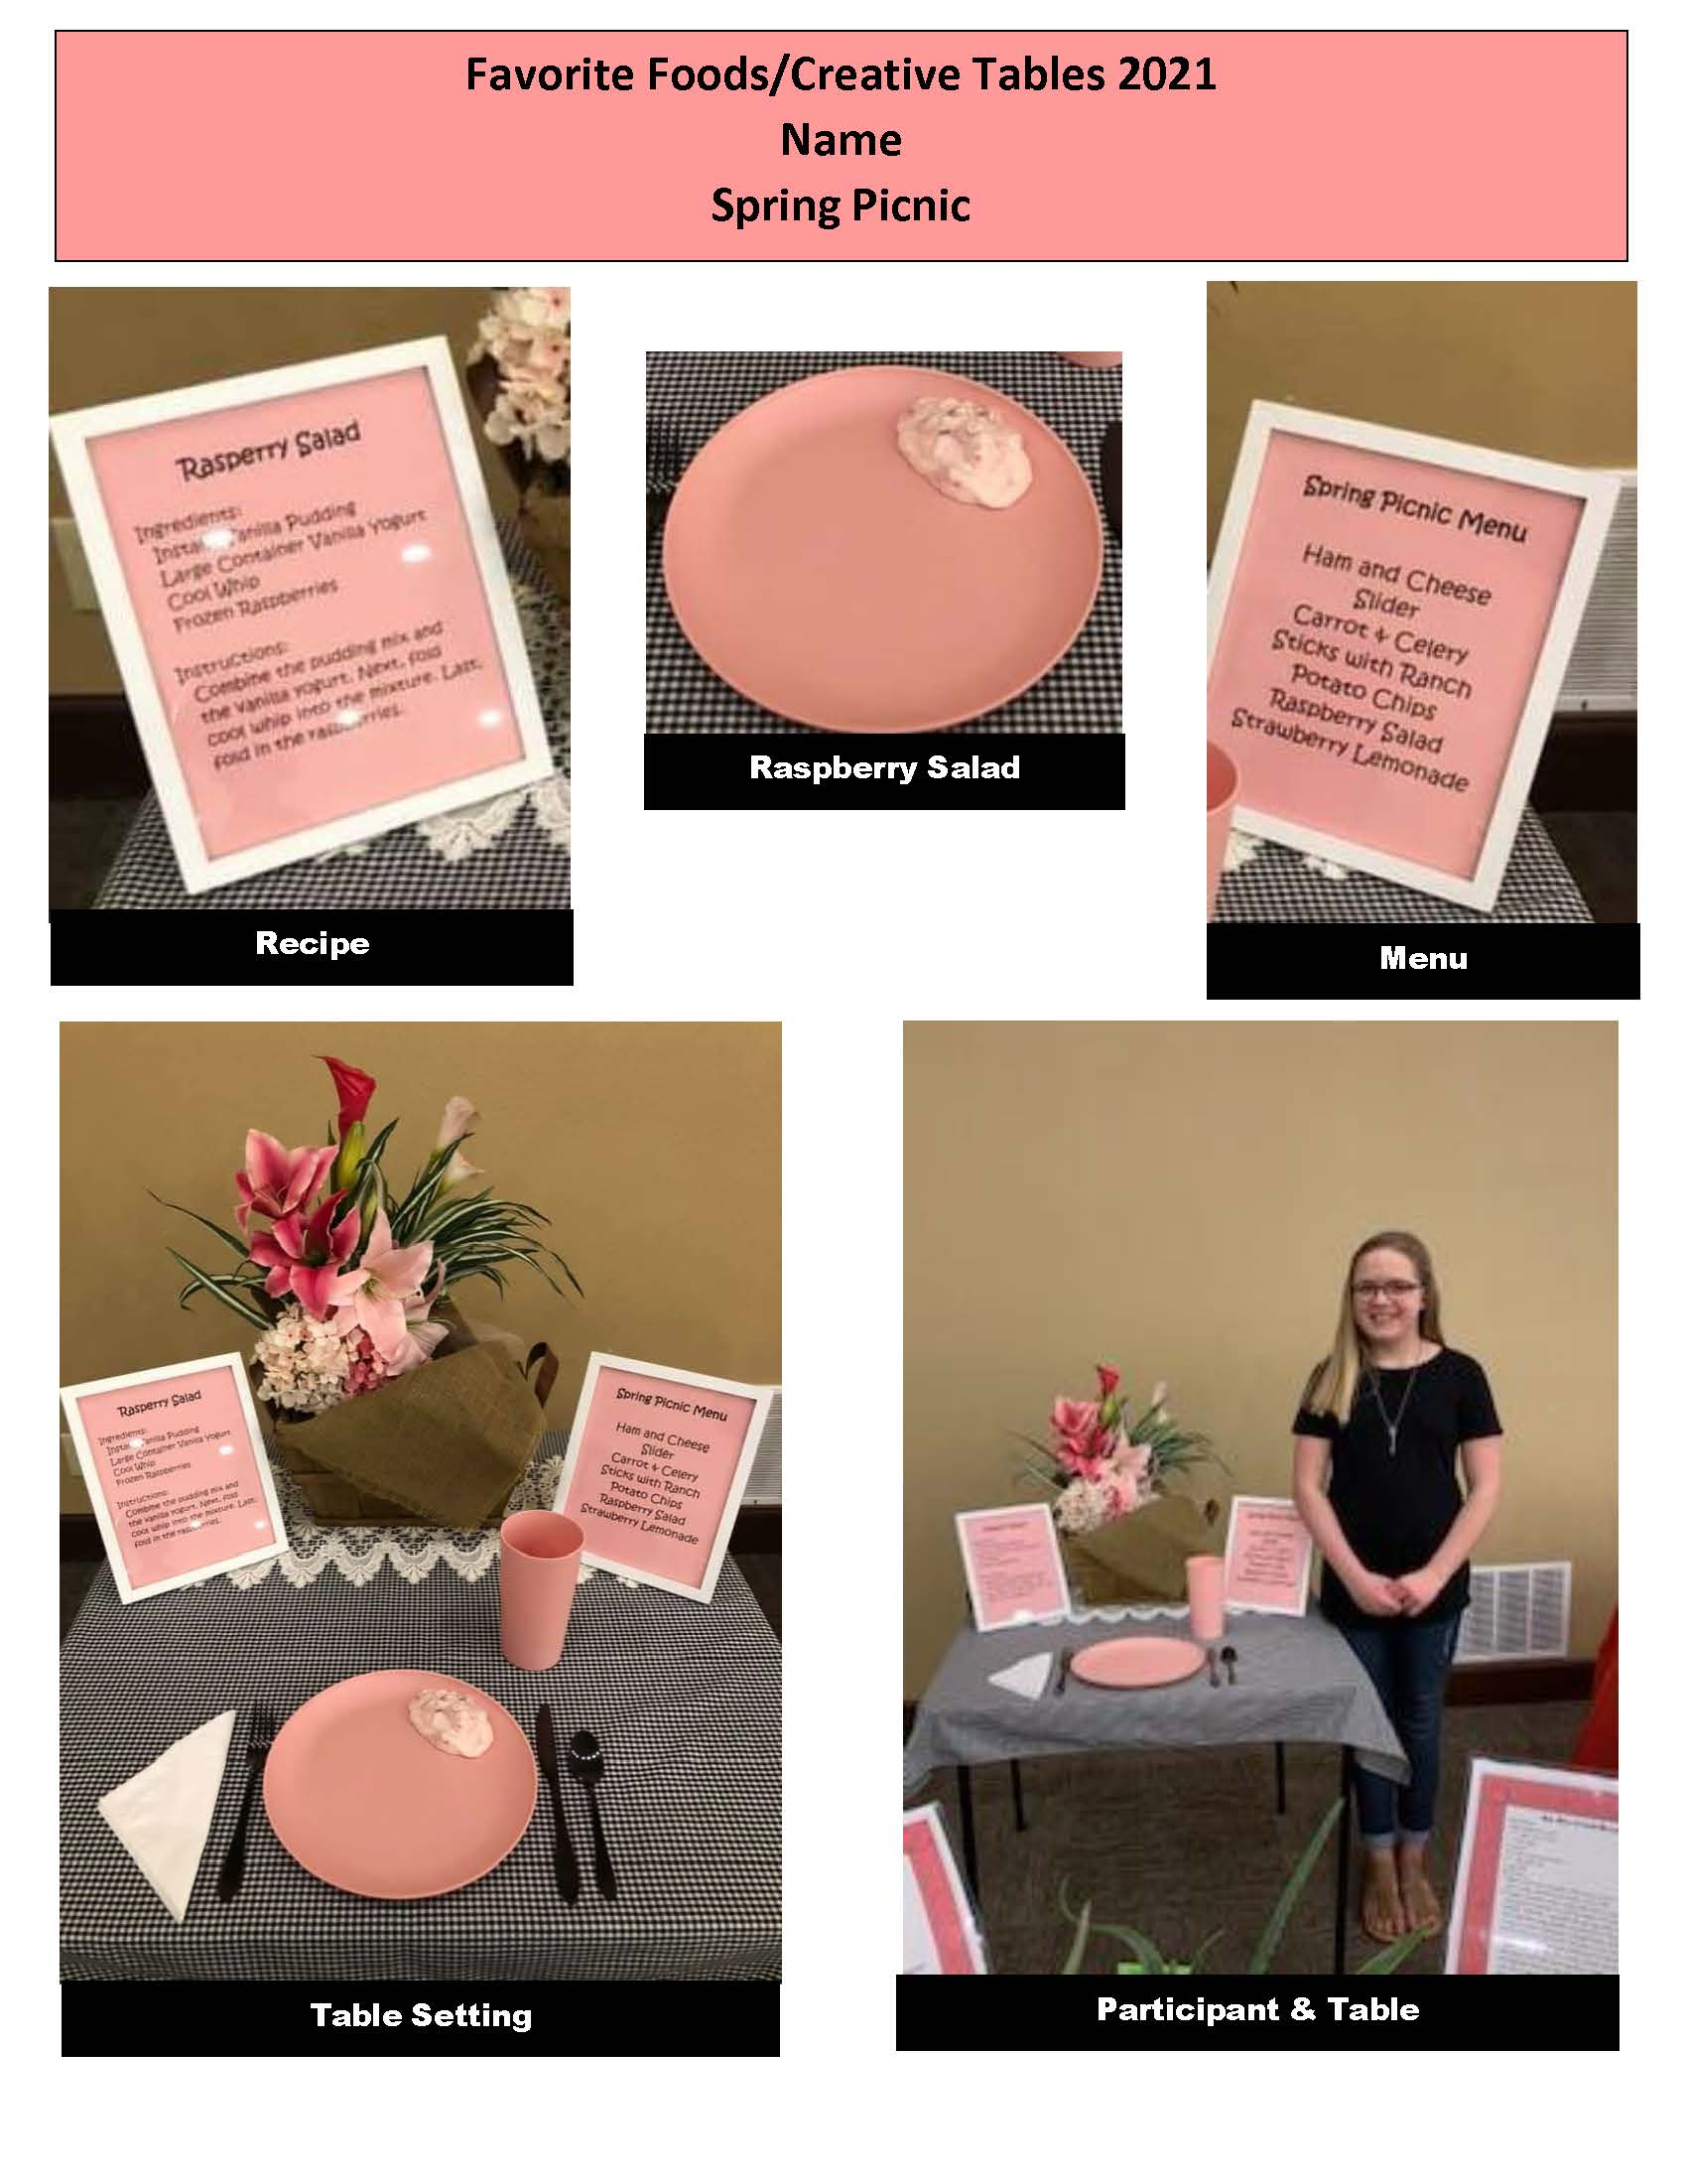

Slide 5
Food Show Score Card :
NAME: __________________________AGE/DIVISION: ________________________ COUNTY:____
FOOD SHOW THEME:_________________________________________
Food Show Appearance:
What the food item is served with:
Suitable for the occasion
Balance in color
Balance in texture
The Table Setting (one place setting):
Appropriate for food to be served
Attractive, color scheme, dishes, food, table linen
Appropriate centerpieces
The Exhibitor:
Understands the preparation of the recipe
Knows what food group your recipe is in.
Personal Appearance - neat, well groomed, dressed appropriately,
for serving the meal or snack.
5. Comments:
Excellent | Good | Needs Improvement
Excellent – Well Done Rating:
Good – Improvements Needed Blue:
Needed Improvement Red:
Consult your leader for help White:

Slide 6
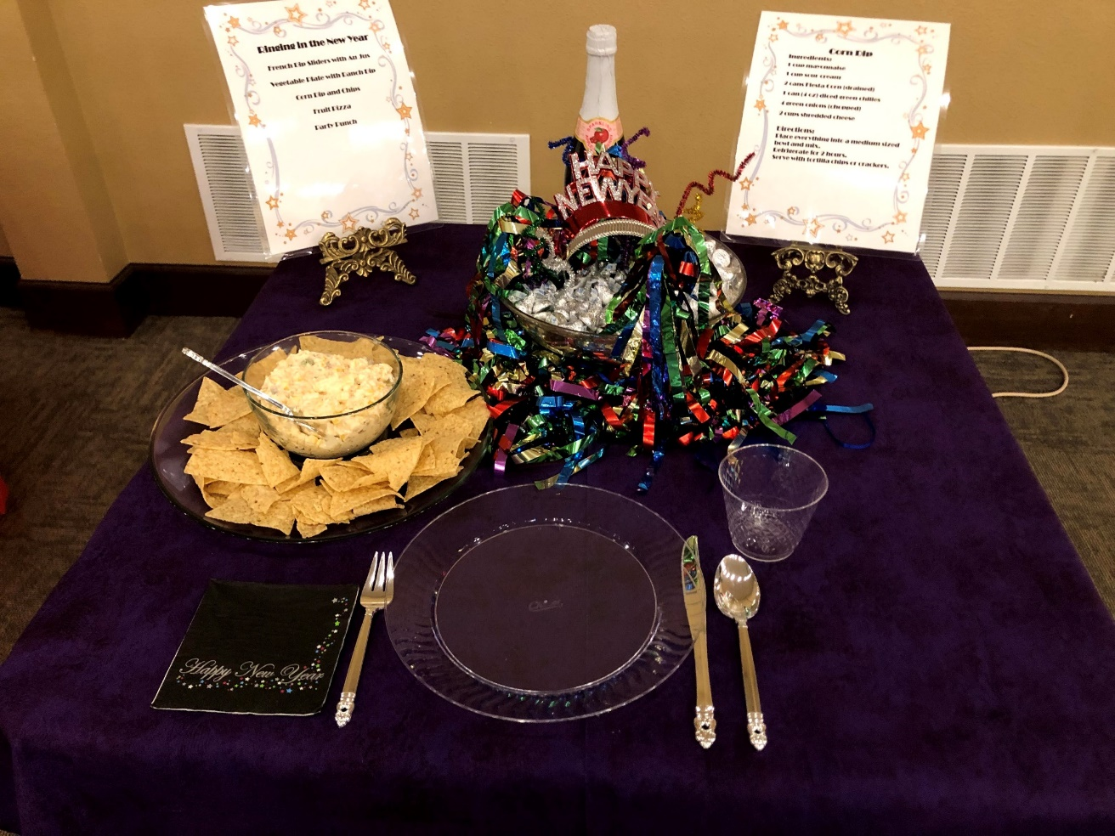
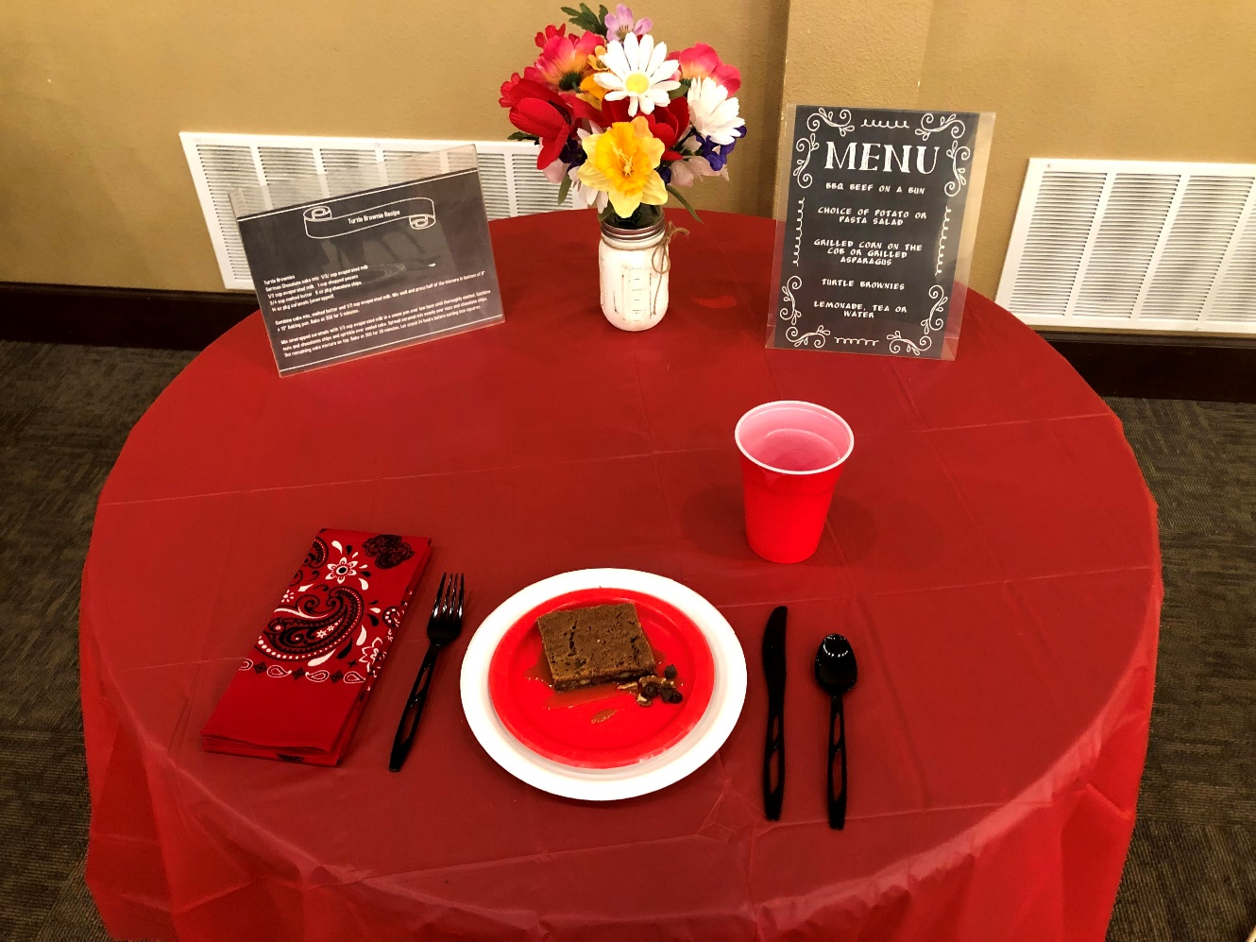
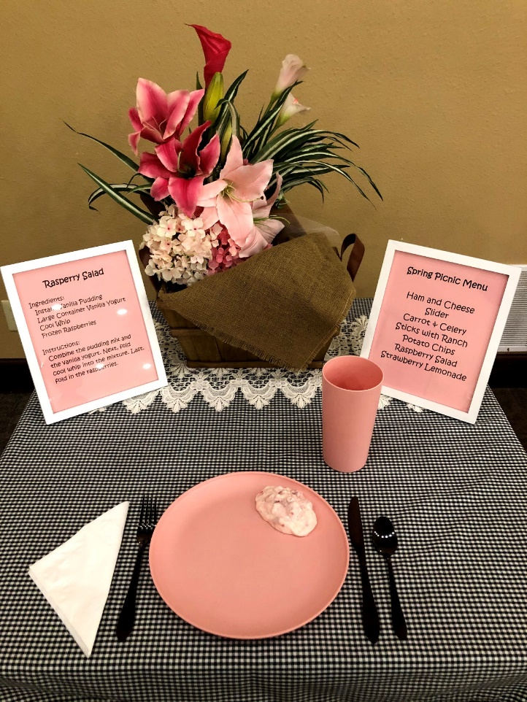
Ideas

Slide 7
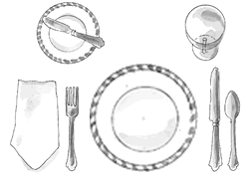
Basic Table Setting
For a basic table setting, here are two great tips to help you–or your kids–remember the order of plates and utensils:
Picture the word “FORKS.” The order, left to right, is F for Fork, O for the Plate (the shape!), K for Knives and S for Spoons. (Okay, you have to forget the R, but you get the idea!)
Holding your hands in front of you, touch the tips of your thumbs to the tips of your forefingers to make a lowercase ‘b’ with your left hand and a lowercase ‘d’ with your right hand. This reminds you that “bread and butter” go to the left of the place setting and “drinks” go on the right. Some other things to know:
Knife blades always face the plate
The napkin goes to the left of the fork or on the plate
The bread and butter knife are optional.
Some other things to know:
Knife blades always face the plate.
The napkin goes to the left of the fork, or on the plate.
The bread and butter knife are optional.

Slide 8
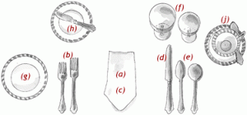
Informal Place Setting
When an informal three-course dinner is served, the typical place setting includes these utensils and dishes:
Our illustration shows how a table would be set for the following menu:
Salad or first course
Entree
Dessert
Soup course

Slide 9
Informal Place Setting (Continued)
(a) Dinner Plate: This is the “hub of the wheel” and is usually the first thing to be set on the table. In our illustration, the dinner plate would be placed where the napkin is, with the napkin on top of the plate.
(b) Two Forks: The forks are placed to the left of the plate. The dinner fork, the larger of the two forks, is used for the main course; the smaller fork is used for a salad or an appetizer. The forks are arranged according to when you need to use them, following an “outside-in” order. If the small fork is needed for an appetizer or a salad served before the main course, then it is placed on the left (outside) of the dinner fork; if the salad is served after the main course, then the small fork is placed to the right (inside) of the dinner fork, next to the plate.

Slide 10
(c) Napkin: The napkin is folded or put in a napkin ring and placed either to the left of the forks or on the center of the dinner plate. Sometimes, a folded napkin is placed under the forks.
(d) Dinner Knife: The dinner knife is set immediately to the right of the plate, cutting edge facing inward. (If the main course is meat, a steak knife can take the place of the dinner knife.) At an informal meal, the dinner knife may be used for all courses, but a dirty knife should never be placed on the table, placemat or tablecloth.
(e) Spoons: Spoons go to the right of the knife. In our illustration, soup is being served first, so the soup spoon goes to the far (outside) right of the dinner knife; the teaspoon or dessert spoon, which will be used last, goes to the left (inside) of the soup spoon, next to the dinner knife.

Slide 11
(f) Glasses: Drinking glasses of any kind — water, wine, juice, iced tea — are placed at the top right of the dinner plate, above the knives and spoons.
Other dishes and utensils are optional, depending on what is being served, but may include:
(g) Salad Plate: This is placed to the left of the forks. If salad is to be eaten with the meal, you can forgo the salad plate and serve it directly on the dinner plate. However, if the entree contains gravy or anything runny, it is better to serve the salad on a separate plate to keep things neater.
(h) Bread Plate with Butter Knife: If used, the bread plate goes above the forks, with the butter knife placed diagonally across the edge of the plate, handle on the right side, and blade facing down.

Slide 12
(i) Dessert Spoon and Fork: These can be placed either horizontally above the dinner plate (the spoon on top with its handle facing to the right; the fork below with its handle facing left); or beside the plate. If placed beside the plate, the fork goes on the left side, closest to the plate (because it will be the last fork used), and the spoon goes on the right side of the plate, to the right of the dinner knife, and to the left of the soup spoon.
(j) Coffee Cup and Saucer: Our illustration shows a table setting that would be common in a restaurant serving a large number of people at once, with coffee being served during the meal. The coffee cup and saucer are placed above and to the right of the knife and spoons. At home, most people serve coffee after the meal. In that case, the cups and saucers are brought to the table and placed above and to the right of the knives and spoons.

Slide 13
The Formal Place Setting
The formal place setting is used at home for a meal of more than three courses, such as a dinner party or a holiday meal.
It’s simply the informal place setting taken to the next level, adding glassware, dishes, and utensils for the foods and beverages served with the additional courses.
It’s also used at high-end restaurants that serve multiple courses.

Slide 14
Everything on your table should be crisp and sparkling. White linens are still considered the most formal but colored, or patterned tablecloths or placemats, and napkins can be just as elegant.
Other possible elements include candles, a centerpiece or multiple flower arrangements, and place cards.
Placemats (if used) are entered in front of each chair, about one to two inches from the edge of the table.
A tablecloth is spread to hang evenly on each end and on the sides. The average drop is 12 to 18 inches, but don’t worry if it is a little long or short—you don’t want it hanging too low, or it will end up in the diners’ laps.

Slide 15
The most formal table is strictly symmetrical:
Centerpiece in the exact center, an even number of candlesticks, place settings spaced evenly around the table,
Silverware lined up and at the same distance from the edge of the table.
The space not taken up by place settings is your available real estate.
Feel free to vary flower arrangements and decorations as you like, creating a balanced and pleasing table.
Be careful not to overcrowd the table, and arrange your decorations so diners seated opposite can see each other.

Slide 16
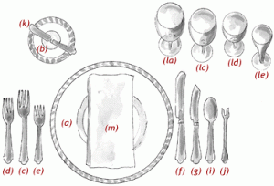

Slide 17
(a) Service Plate: This large plate, also called a charger, serves as an under-plate for the plate holding the first course, which will be brought to the table. When the first course is cleared, the service plate remains in place for any other courses, such as a soup course, until the plate holding the entrée is served, at which point the two plates are exchanged. The charger may serve as the under-plate for several courses that precede the entrée.
(b) Butter Plate: The small butter plate is placed above the forks at the left of the place setting.
(c) Dinner Fork: The largest of the forks, also called the place fork, is placed on the left of the plate. Other smaller forks for other courses are arranged to the left or right of the dinner fork, according to when they will be used.

Slide 18
(d) Fish Fork: If there is a fish course, this small fork is placed to the left of the dinner fork because it is the first fork used.
(e) Salad Fork: If the salad is served after the entrée, the small salad fork is placed to the right of the dinner fork, next to the plate. If the salad is to be served first and fish second, then the forks would be arranged (left to right): salad fork, fish fork, dinner fork.
(f)Dinner Knife: The large dinner knife is placed to the right of the dinner plate.
(g) Fish Knife: The specially shaped fish knife goes to the right of the dinner knife.

Slide 19
(h) Salad Knife (Note: there is no salad knife in the illustration): If used, according to the above menu, it would be placed to the left of the dinner knife, next to the dinner plate. If the salad is to be served first, and fish second, then the knives would be arranged (left to right): dinner knife, fish knife, salad knife.
(i) Soup Spoon or Fruit Spoon: If soup or fruit is served as a first course, then the accompanying spoon goes to the right of the knives.
(j) Oyster Fork: If shellfish are to be served, the oyster fork goes to the right of the spoons. Note: It is the only fork ever placed on the right of the plate.
(k) Butter Knife: The small spreader is paced diagonally on top of the butter plate, handle on the right, and blade down.

Slide 20
(l) Glasses: These are placed on the right, above the knives and spoons. They can number up to five and are placed in the order they will be used. When there are more than three glasses, they can be arranged with smaller glasses in front. The water goblet (la) is placed directly above the knives. Just to the right are placed a red (lc) or white (ld) wine glass. A sherry glass or champagne flute (le), to accompany a first course or for an opening toast, go to the right of the wine glasses. Glasses used for a particular course are removed at the end of the course.
(m) Napkin: The napkin is placed on top of the charger (if one is used) or in the space for the plate. It can also go to the left of the forks or under the forks if space is tight.

